Slide 2
See3PO
See3PO
Our robot, equipped with two cameras, will use vision to navigate its environment
Host
An application that runs on a Host PC, allowing the operator to set up and direct the robot.

Slide 3
Floor Plan Processing
Floor Tile – represents one square foot on a floor.
Walkability - We can hold a range of values, but currently, we only use:
Floor = 1
Wall = 0
End/Start – booleans showing whether this is this tile is the start or endpoint of the graph.
Floor Plan
An Array of Floor Tiles
Start/End – pointers to the start and end tiles

Slide 4
Path Finder
Converts the floorTile array into a graph structure.
Each tile is connected to each of its four neighbors if that neighbor’s walkability is not zero.
The getPath() method returns the shortest path between the start node and the destination node.
Currently uses Djikstra’s algorithm for shortest path in order to account for varying “Walkability” of tiles.

Slide 5
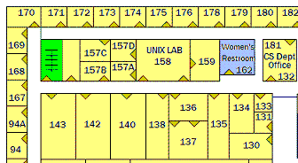
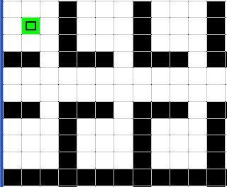
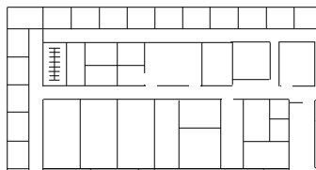

Path Finder
walkable
wall
s
Floor Plan
Processing
t
Science Building – 3F (image)
Graph /
Path Finder
Confirm Position
Position Finder
s
s
t
Generate
Move Command
t

